Slide 2
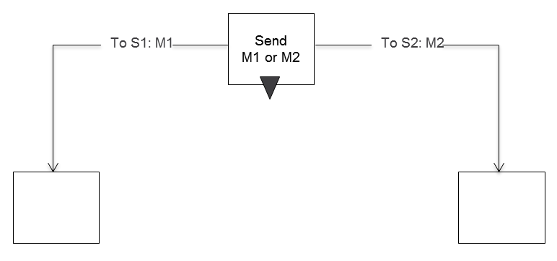
Send

Slide 3
Send Timeout

Slide 4
Receive

Slide 5
Receive Timer

Slide 6
Receive-Break

Slide 7
Symbols Behavior

Slide 8
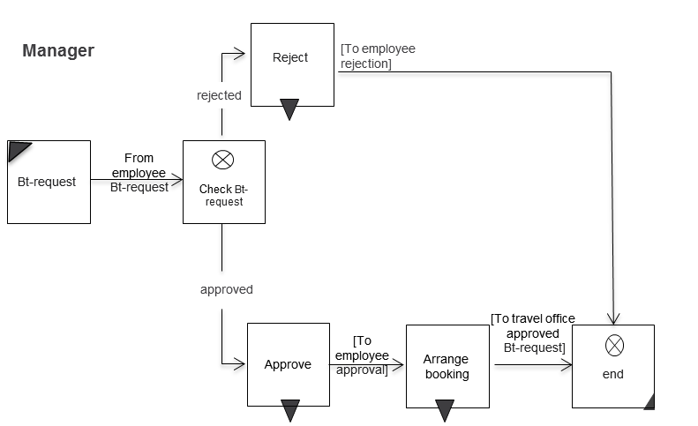
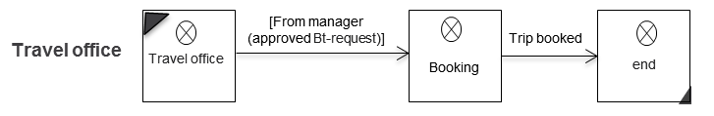
Beispiel

